Slide 1
Homework 1
Sokoban
Introduction to Parallel Computing
2022/03/01

Slide 2
https://hackmd.io/@ipc22/hw1

Slide 3
Sokoban
倉庫番, sōko-ban
“a puzzle video game genre in which the player pushes crates or boxes around in a warehouse, trying to get them to storage locations.” - Wikipedia

Slide 4
Goal
Implement a solver for Sokoban called hw1.cc
Parallelize it with threads
Pthread or std::thread
OpenMP

Slide 5
Input
o: The player stepping on a regular tile
O: The player stepping on a target tile
x: A box on a regular tile
X: A box on a target tile
: Nothing on a regular tile
.: Nothing on a target tile
#: Wall
@: A fragile tile
!: The player stepping on a fragile tile
samples/01.txt
#########
# xox..#
# #####
#########

Slide 6
Output
Print a valid sequence of actions that pushes all the boxes to the target tiles
Directions: “W”, “A”, “S”, “D”
e.g. : DDAAASAAWDDDD for 01.txt

Slide 7
Resources
/home/ipc22/share/hw1
example_solver.py
samples
play.py
validate.py
Makefile

Slide 8
Resources
/home/ipc22/share/hw1
example_solver.py
samples
play.py
validate.py
Makefile
Sample test cases
01.txt
02.txt
…
20.txt

Slide 9
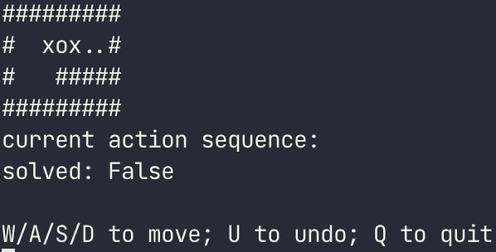
Resources
/home/ipc22/share/hw1
example_solver.py
samples
play.py
validate.py
Makefile
Play the game interactively
$ /home/ipc22/share/hw1/play.py \ /home/ipc22/share/hw1/samples/01.txt

Slide 10
Resources
/home/ipc22/share/hw1
example_solver.py
samples
play.py
validate.py
Makefile
Check whether the output is correct
$ echo “DDAAASAAWDDDD” | /home/ipc22/share/hw1/validate.py \ /home/ipc22/share/hw1/samples/01.txt -
Output: OK
$ srun -c6 -o answer.txt ./hw1 01.txt $ /home/ipc22/share/hw1/validate.py 01.txt answer.txt

Slide 11
Resources
/home/ipc22/share/hw1
example_solver.py
samples
play.py
validate.py
Makefile
A simple way to compile your program. Tutorial
Put Makefile and hw1.cc into the same directory
$ make hw1 , or $ make to compile your hw1.cc as hw1
$ make clean to remove the executable file

Slide 12
Compile & Execute
Compile
$ g++ -std=c++17 -O3 -pthread -fopenmp hw1.cc -o hw1
Execute
$ ./hw1 /path/to/testcase
$ srun -n1 -c6 ./hw1 /home/ipc22/share/hw1/samples/01.txt

Slide 13
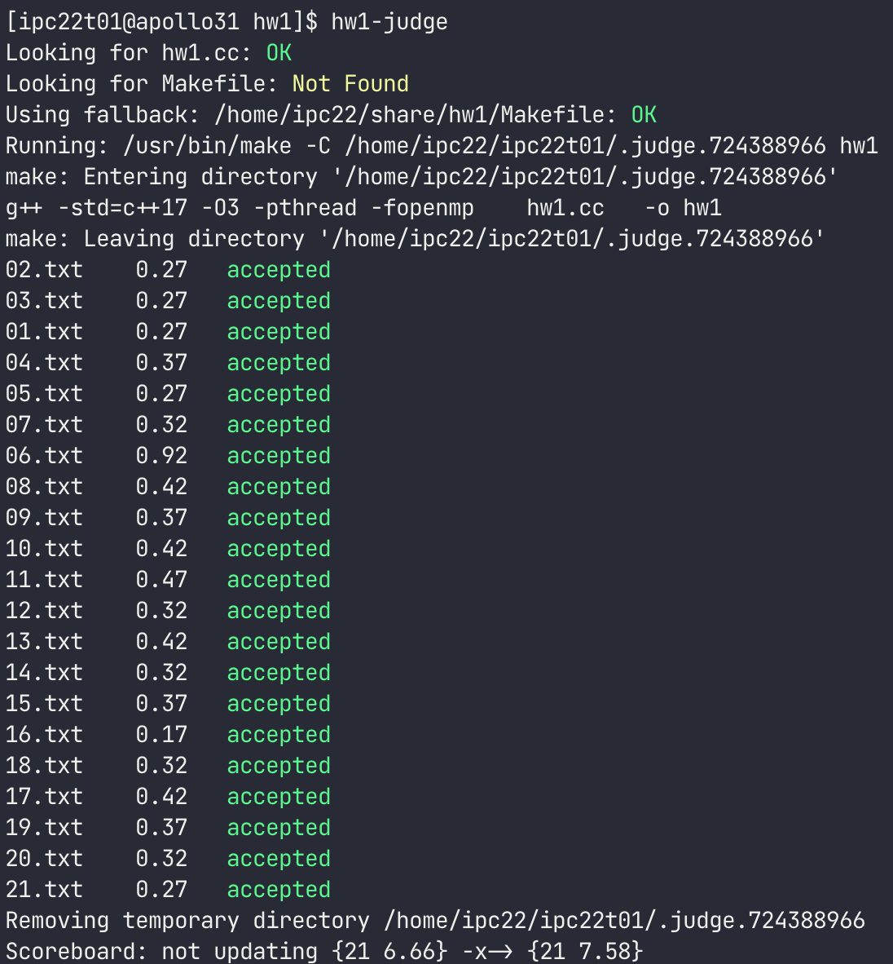
Judge
Type hw1-judge in the directory of hw1.cc
Scoreboard: https://apollo.cs.nthu.edu.tw/ipc22/scoreboard/hw1/

Slide 14
Report
Answer the following questions, in either English or Traditional Chinese.
Briefly describe your implementation.
What are the difficulties encountered in this homework? How did you solve them? (You can discuss about hard-to-optimize hotspots, or synchronization problems)
What are the strengths and weaknesses of pthread and OpenMP?
(Optional) Any suggestions or feedback for the homework are welcome.

Slide 15
Submission
Due: Tue, 2022/3/15 23:59
Submit the following files to EEClass:
hw1.cc
report.pdf
Makefile (optional)
ipc22<uid>.txt (optional) (e.g. ipc22s01.txt) Custom map to be added to hidden test cases. The size of the map should less than 256 pixels.

Slide 16
Hint
#include <omp.h>
#include <thread>
int main() {
int a[100], b[100], c[100];
cpu_set_t cpu_set;
sched_getaffinity(0, sizeof(cpu_set), &cpu_set);
int cpucnt = CPU_COUNT(&cpu_set);
#pragma omp parallel for schedule(static) num_threads(cpucnt)
for (int i = 0; i < 100; i++)
a[i] = b[i] * c[i];
}
OpenMP:
cpucnt: cpus available for the program
Schedule:
Static (default)
Dynamic
Guided

Slide 17
Hint
#include <omp.h>
#include <thread>
#include <cstdio>
int main() {
int a[100], b[100], c[100];
int cnt = 0;
#pragma omp parallel for schedule(static)
for (int i = 0; i < 100; i++) {
a[i] = b[i] * c[i];
int tid = omp_get_thread_num();
printf("threadID: %d", tid);
#pragma omp critical
{
if (a[i] == 0)
cnt = cnt + 1;
}
}
}
OpenMP:
Get thread id: omp_get_thread_num()
Critical section: #pragma omp critical

Slide 18
Hint
Other test cases: http://sneezingtiger.com/sokoban/levels.html
Algorithm: BFS, A-star, … check /home/ipc22/share/hw1/example_solver.py
Discuss with your friends!
Plagiarisms are PROHIBITED

Slide 19
Q & A
Feel free to ask if you have any questions.

